Slide 1
Working with Databases

Slide 2
MySQL Connector
MySQL Commands
Using Python Functions
Stored procedures

Slide 3
MySQL Connector
MySQL database has a two-step process for database creation:
Make a connection to a MySQL server.
Execute a separate query to create the database.
Install pip
Install MySQL connector > python –m pip install mysql-connector-python

Slide 4
Create Connection
import mysql.connector mydb = mysql.connector.connect( host="localhost", user="root", //your user name here password="root" //your password here ) print(mydb)

Slide 5
Python MySQL Commands
Creating a Database
Create a table
Insert into tables
Select Query
Delete table/rows
Stored Procedures

Slide 6
Creating a Database
import mysql.connector mydb = mysql.connector.connect( host="localhost", user="root", //your user name here password="root" //your password here ) mycursor = mydb.cursor() mycursor.execute("CREATE DATABASE craftDatabase")

Slide 7
Show Databases
import mysql.connector mydb = mysql.connector.connect( host="localhost", user="root", password="root" ) mycursor = mydb.cursor() mycursor.execute("SHOW DATABASES")
for db in mycursor: print(db)

Slide 8
Using Functions
import mysql.connector
def create_connection(host_name,usr_name,usr_pwd): connection = mysql.connector.connect( host= host_name, user= usr_name , password=usr_pwd
return connection
//calling the function
connection = create_connection( "localhost", "root", "root")
def create_db(connection, query): mycursor = connection.cursor()
mycursor.execute(query)
print("Database created successfully")
//calling functions to create database
query = "CREATE DATABASE craftDatabase"
create_db(connection, query)

Slide 9
Python MySQL Create Table
import mysql.connector mydb = mysql.connector.connect( host="localhost", user="root", password="root“, database = "craftDatabase") mycursor = mydb.cursor() mycursor.execute( "CREATE Table students(name varchar(255), address varchar(255))")

Slide 10
Show Tables
import mysql.connector mydb = mysql.connector.connect( host="localhost", user="root", password="root“,
database=“craftDatabase") mycursor = mydb.cursor() mycursor.execute("SHOW TABLES")
for tb in mycursor: print(tb)

Slide 11
Using Functions
import mysql.connector
def create_connection(host_name,usr_name,usr_pwd, db): connection = mysql.connector.connect( host= host_name, user= usr_name , password=usr_pwd,
database=db)
return connection
//calling the function
connection = create_connection( "localhost", "root", "root", “craftDatabase" )

Slide 12
def execute_query(connection, query): mycursor = connection.cursor()
mycursor.execute(query)
connection.commit()
print("Query executed successfully")

Slide 13
Calling functions to create database
create_table_query = "CREATE Table craft_students(
id int AUTO_INCREMENT, name text NOT NULL, age int,
gender text, nationality text,
PRIMARY KEY(id))"
execute_query(connection, create_table_query)

Slide 14
Python MySQL INSERT INTO Tables
mycursor = mydb.cursor()
sql = "INSERT INTO students(name, address)
VALUES (%s, %s)"
val = ("Yohannes", "Los Angeles") mycursor.execute(sql, val)
mydb.commit()
print(mycursor.rowcount, "record(s) inserted")

Slide 15
INSERT Multiple Rows
To insert multiple rows into a table, use the executemany() method.
The second parameter of the executemany() method is a list of tuples, containing the data you want to insert:
sql = "INSERT INTO students(name, address) VALUES (%s, %s)"
val = [
("Yohannes", "Los Angeles"),
("Jemal", "Virginia"),
("Solomon", "Texas"),
("Tekle", "Ohio") ]
mycursor.executemany(sql, val)
mydb.commit()
print(mycursor.rowcount, "record(s) inserted")

Slide 16
Python MySQL SELECT FROM
sql = "SELECT * FROM students"
mycursor.execute(sql)
result = mycursor.fetchall()
for val in result: print(val)

Slide 17
Python MySQL DELETE
sql = "DELETE FROM students WHERE address = ‘Ohio’"
mycursor.execute(sql)
mydb.commit()
print(mycursor.rowcount, "record(s) deleted")

Slide 18
Parameterized Query( %s PLACEHOLDER)
A parameterized query is a query in which placeholders (%s) are used for parameters (column values) and the parameter values supplied at execution time.
Escape values by using the placeholder %s method:

Slide 19
sql = "DELETE FROM students WHERE address = %s"
addr = ("Texas",)
mycursor.execute(sql, addr)
mydb.commit()
print(mycursor.rowcount, "record(s) deleted")

Slide 20
More Examples
import mysql.connector
def create_connection(host_name,usr_name,usr_pwd, db): connection = mysql.connector.connect( host= host_name, user= usr_name , password=usr_pwd,
database=db)
return connection
//calling the function
connection = create_connection( "localhost", "root", "root", “craftDatabase" )

Slide 21
a func that can execute any query
def execute_query(connection, query): mycursor = connection.cursor()
mycursor.execute(query)
connection.commit()

Slide 22
Create table query
create_table_query = """ CREATE TABLE laptop_table(
id int, name text, price int,
purchase_date date) """

Slide 23
/Create the table by executing the function
execute_query(connection, create_table_query)

Slide 24
a function to insert values into the created table
def insertValIntoTable(connection, id, name, price, purchase_date): mycursor = connection.cursor()
sql_stmt = "INSERT INTO laptop(id,name,price,purchase_date)
VALUES (%s, %s, %s, %s)"
record = (id, name, price, purchase_date)
mycursor.execute(sql_stmt, record)
connection.commit()

Slide 25
call the function that inserts values
insertValIntoTable(connection, 101, ‘Dell’, 3500, ‘2022-02-12’)
insertValIntoTb(connection, 102, ‘Lenovo’, 1200, ‘2023-01-11’)
insertValIntoTb(connection, 103, ‘MacBook’, 2500, ‘2020-03-10’)
insertValIntoTb(connection, 104, ‘HP’, 1500, ‘2012-08-13’)

Slide 26
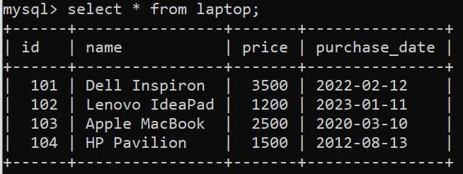
OUTPUT
If you have properly written and executed the previous code snippets, you would have the following output:

Slide 27
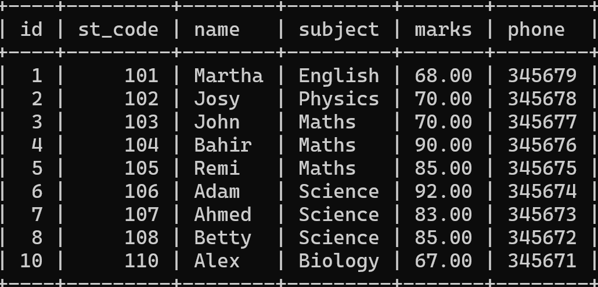
Stored Procedures
In SQL, stored procedure is a set of statement(s) that perform some defined actions. We make stored procedures so that we can reuse statements that are used frequently. Use the following table for examples

Slide 28
Let's have a procedure that displays all records of the student_info table whose marks are greater than 70 and count all the table rows.
DELIMITER &&
CREATE PROCEDURE student_with_high_grade()
BEGIN
SELECT * FROM student_info WHERE marks > 70;
SELECT COUNT(st_code) AS total_student FROM student_info;
END &&
DELIMITER ;
CALL student_with_high_grade();

Slide 29
Calling Stored Procedure from Python
To call MySQL stored procedure from Python, you need to follow these steps:
Connect to MySQL from Python
Get Cursor Object from Connection Next, use a connection.cursor() method to create a cursor object. This method creates a new MySQLCursor object.
Execute the stored procedure Execute the stored procedure using the cursor.callproc(). here, you must know the stored procedure name and its IN and OUT parameters.
Fetch results Once the stored procedure executes successfully, we can extract the result using a cursor.stored_results()

Slide 30
Execute the student_with_high_grade() stored procedure using Python
import mysql.connector as mc
conn= mc.connect( host = "localhost", user = "root", password = "root" database = "craftDatabase" )
mycursor = conn.cursor()
mycursor.callproc("student_with_high_grade")
for result in mycursor.stored_results():
print(result.fetchall())

Slide 31
Using Python Functions
def find_highGrade(): connection = mysql.connector.connect( host= ‘localhost’, user= ‘root’,
password=‘root’,
database=‘craftDatabase’)
mycursor = connection.cursor()
mycursor.callproc("student_with_high_grade")
for result in mycursor.stored_results():
print(result.fetchall())

Slide 32
Challenge
Write a python code that can execute stored procedures with multiple parameters including IN & OUT

